Slide 1
Amazon Sales Data Analysis Report
Submitted By: Riya Patel
(IC-2K19-70)
Submitted To:
Dr. Kirti Mathur

Slide 2
Objective
Examine and clarify the trends and patterns present in Amazon's sales data to deepen our understanding of sales performance over time.

Slide 3
Problem Statement
Sales management has gained importance to meet increasing competition and the need for improved methods of distribution to reduce cost and to increase profits. Sales management today is the most important function in a commercial and business enterprise.
Do ETL: Extract-Transform-Load some Amazon dataset – Sales Trends
Find key metrics and factors and show the meaningful relationships between attributes.

Slide 4
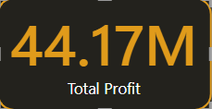
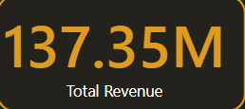
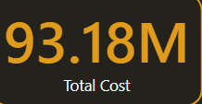
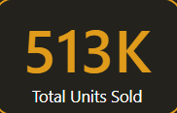
KPIs(Key Performance Indicator)

Slide 5
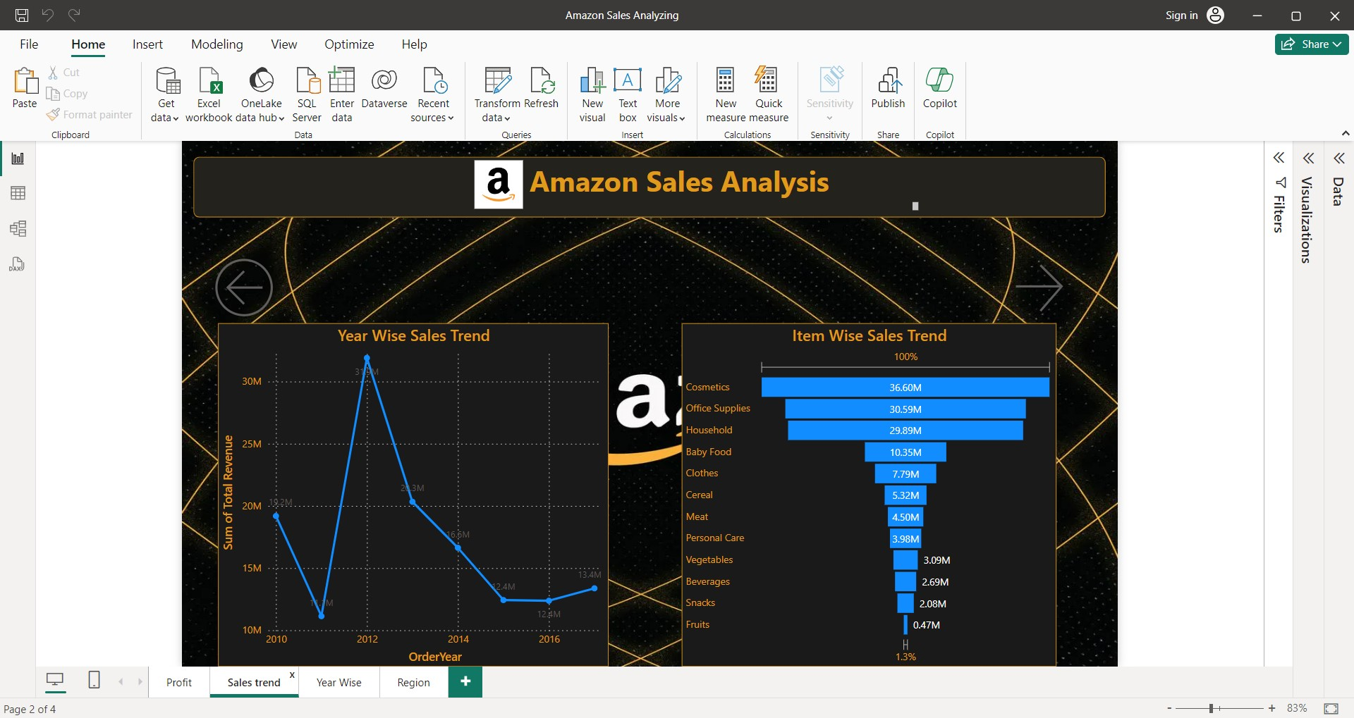
Trends

Slide 6
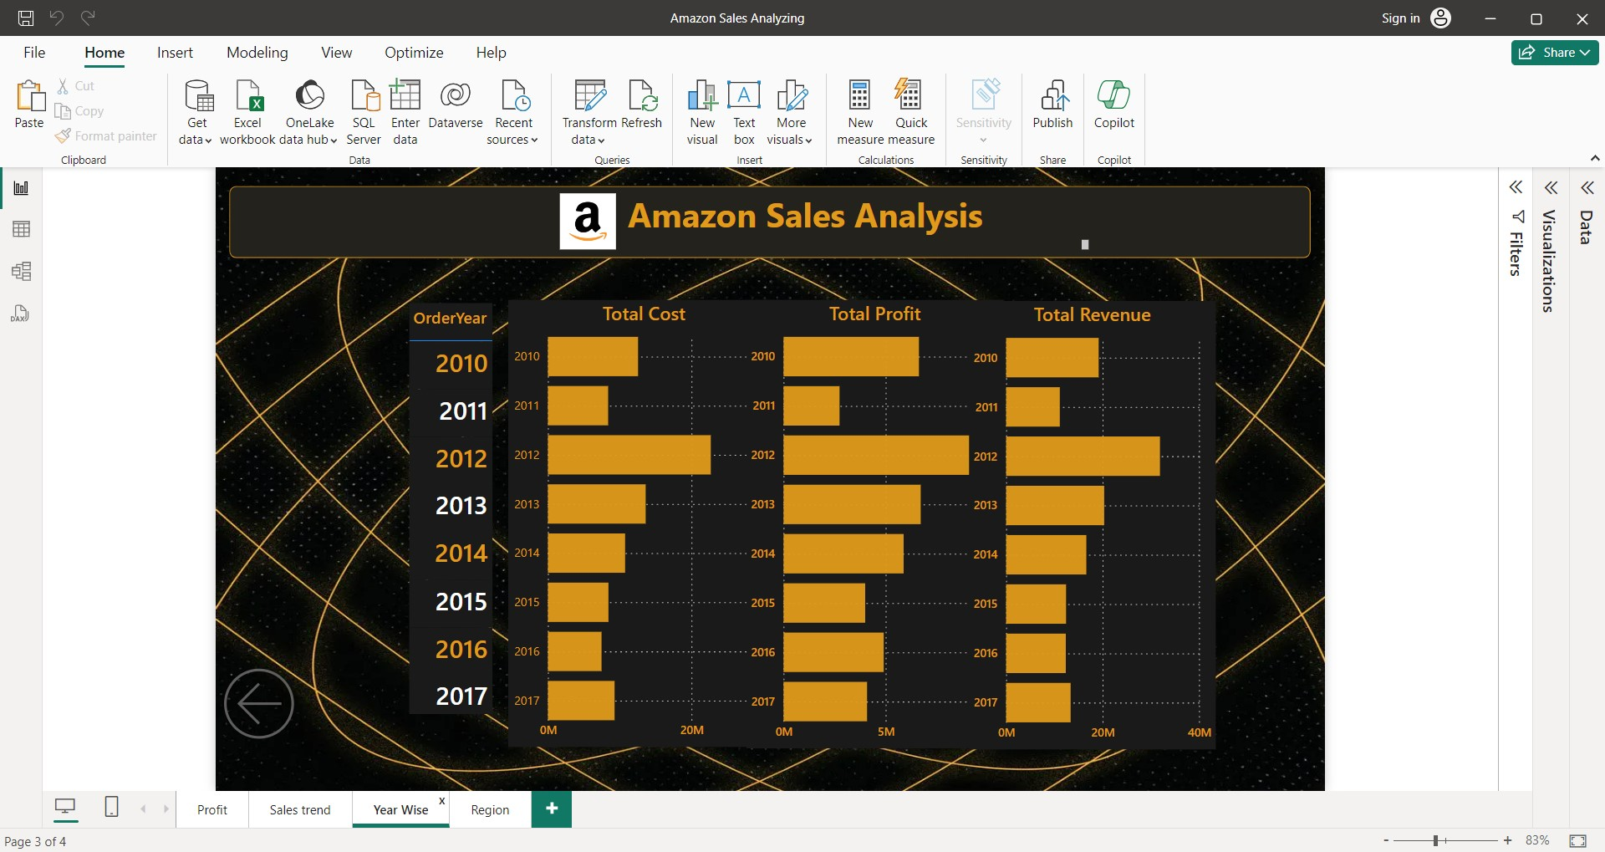
Year wise Profit, Revenue, Cost

Slide 7
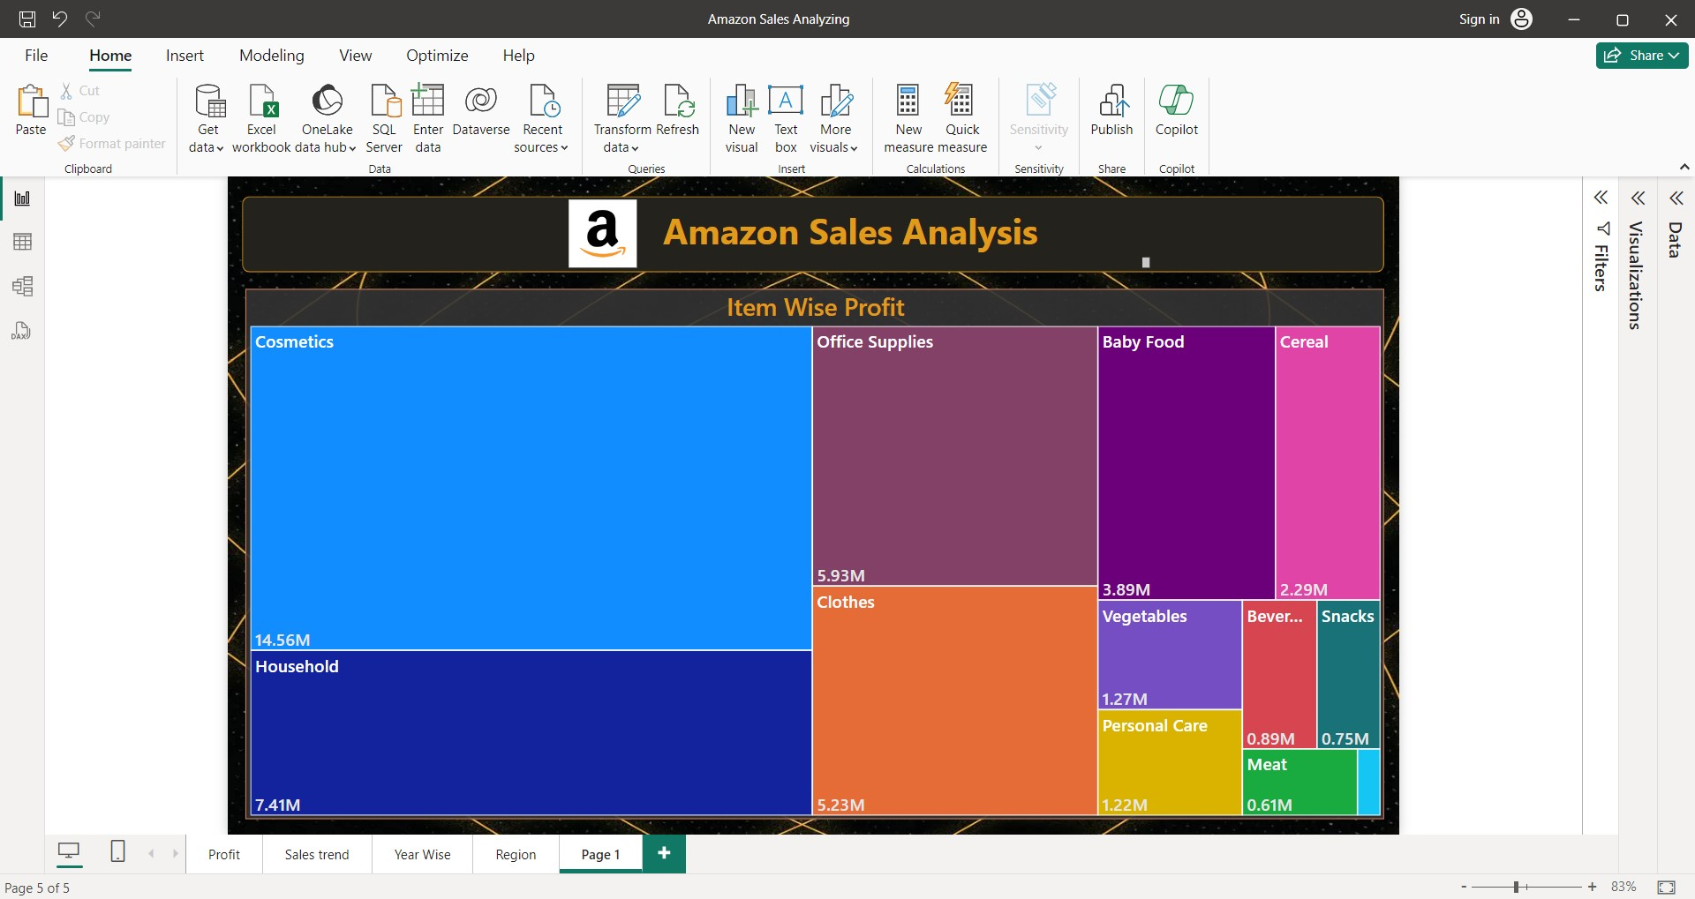
Item wise Profit

Slide 8
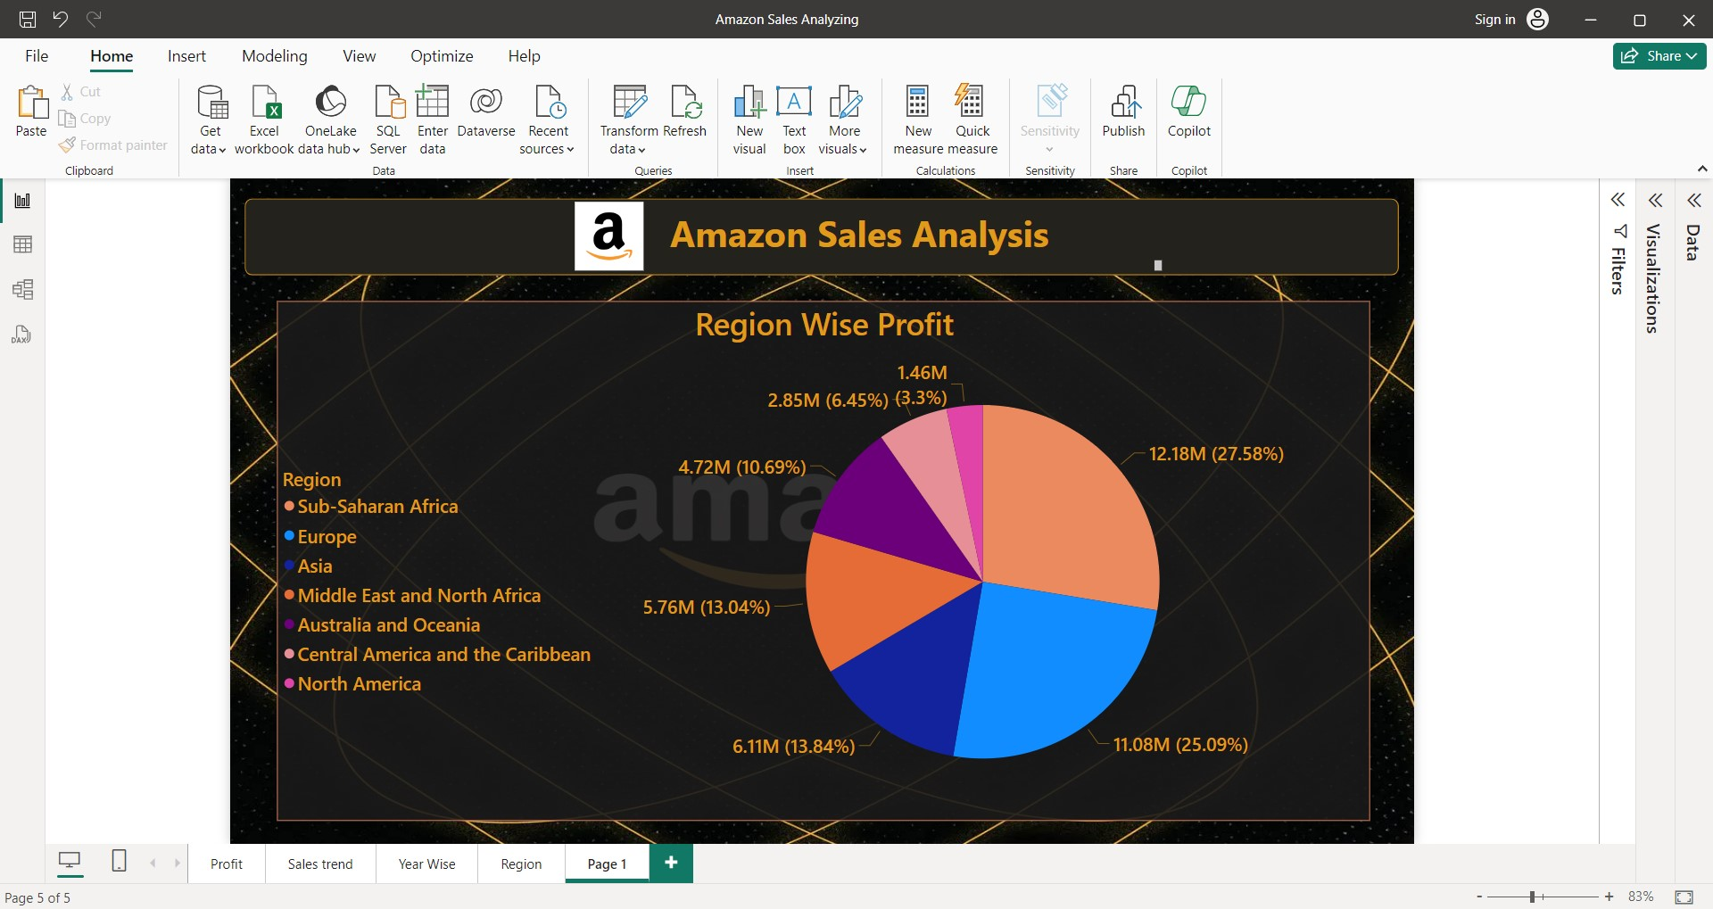
Region wise Profit

Slide 9
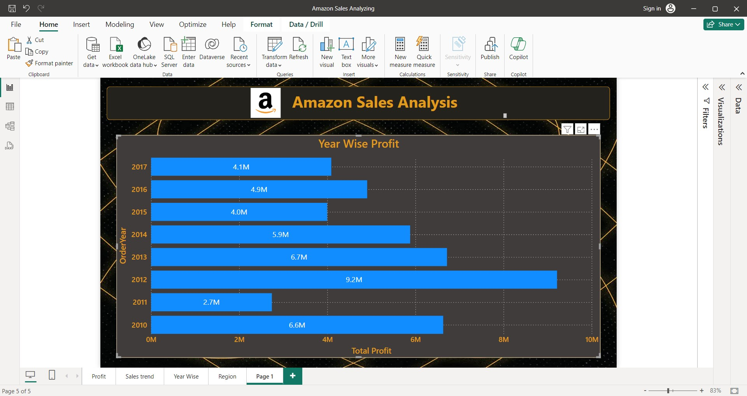
Year wise Profit

Slide 10
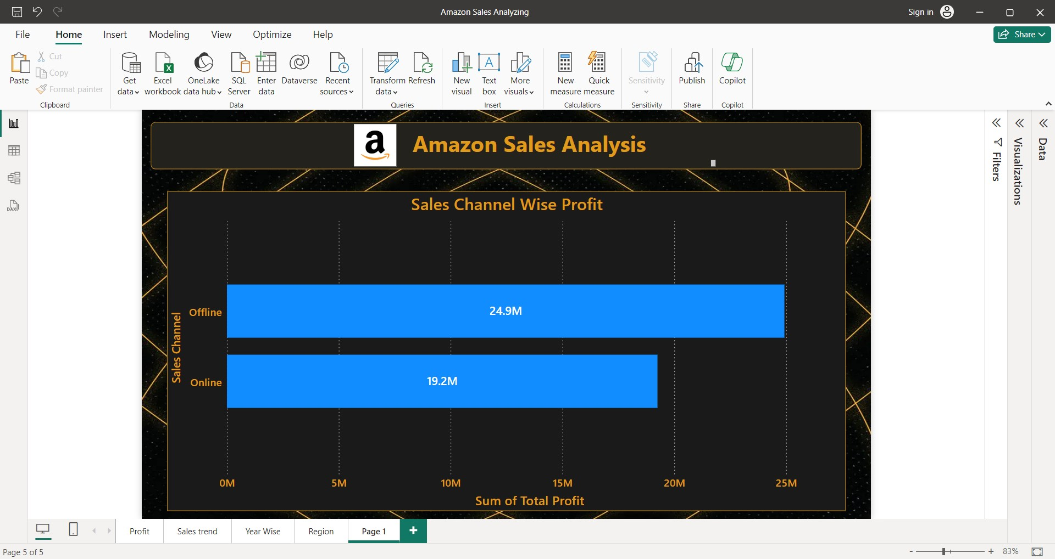
Sales wise Profit

Slide 11
Conclusion
1. 2012 has the highest profit of 9.21M.
2. 2011 has the lowest profit of 2.74M.
3. Cosmetics are the highest profit item at 14.56M.
4. Fruits are the lowest profit item at 1.20M.
5. Sub-Saharan Africa has the highest profit of 12.18M.
6. North-America has the lowest profit of 1.46M.
7. Offline sales Channel has the profit of 24.92M.
8. Online sales Channel has the profit of 19.25M.

Slide 12
Thank You

